Slide 1

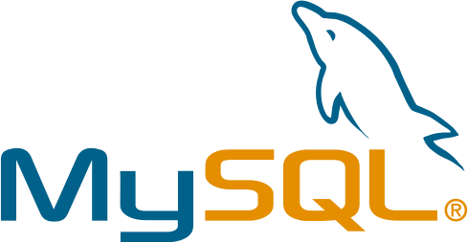
PostgreSQL vs MySQL
Presented by:

Slide 2
Outline
Introduction
MySQL Spin-Offs
Similarities
Major Differences
Minor Differences
  Acid Complience
  Table Locking
  Json Support
  Joins
  Data Integrity
  Data Types
  Transactions and Rollbacks
  Performance Tuning
  Non-SQL compliant Functions
Conclusion
References

Slide 3
Introduction
 | PostgreSQL | MySQL
Initial Release | July 1996 | May 1995
Stable Release | October 2016 | October 2016
Developer | PostgreSQL Global Development Group | MySQL AB (now owned by Oracle Corporation)
Written in | C | C / C++
Platforms | Windows, Linux, FreeBSD, OpenBSD, NetBSD, OS X, AIX, HP-UX, Solaris, UnixWare | Windows, Linux, FreeBSD, OpenBSD, NetBSD, OS X, AIX, HP-UX, Solaris, UnixWare, BSDi, eComStation, IRIX, Novell NetWare, QNX, Symbian, SunOS, SCO OpenServer, Sanos, Tru64

Slide 4
MySQL Spin-offs
Two widely-used forks
  MariaDB
  Percona Server

Slide 5
Similarities

Slide 6
Major Differences

Slide 7
Minor Differences
Acid Complience
Table Locking
Json Support
Joins
Data Integrity
Data Types
Transactions and Rollbacks
Performance Tuning
Non-SQL compliant Functions

Slide 8
Minor Differences (cont’d)
Differences implemented better
Spatial extensions
Row-level locking
Difference between user and role
Storage type
Postgres more object oriented

Slide 9
Conclusion

Slide 10
References

